Slide 1


sd
Analyzing 311 Responses
Team 1 : Ivan Nikitovic - Haoxuan Sun - Stephen Wong
PROJECT SUMMARY
At-Large City Councilor Julia Mejia seeks to understand the city’s response to 311 service requests and if they are resolving them in an equitable manner. We attempted to understand which communities feel empowered in Boston to demand services and how the city responds to empowered residents.
PROJECT RESULTS / DELIVERABLES
No relationship currently found between voting turnout and city responsiveness to 311 requests.
Weak negative relationship found between number of 311 calls and the level of social vulnerability per census tract. The more empowered a community is, the more likely they are to submit a report to 311.
Strong negative relationship found between between voting turnout and the level of social vulnerability per census tract. The more vulnerable a community is, the less likely they are to vote, historically.
EXTENSION PROJECT RESULTS/DELIVERABLE
Idea: Analyze the relationship between property violations and 311 requests.
Aim: Allocate specific resources to neighborhoods with high rates of building violations to mitigate public safety risks and improve quality of life.
Data: Boston government dataset (https://data.boston.gov/dataset/building-and-property-violations1)
RESULTS
Strong positive relationship found between the number of 311 calls and number of property violations.
Dorchester, East Boston, Roxbury, and South Boston have the highest number of property violations, and account for half of all of the reported property violations in Boston.
CLIENTS OR MENTORS
Julia Mejia - At Large Boston City Councilor julia.jejia@boston.gov
Luz Perez - Chief of Staff for Councilor Mejia luz.perez@boston.gov
REFLECTIONS
We heavily improved our data science, coding, presentation, and communication skills. This project incorporated all aspects of a team project and was an amazing experience.
TECH STACK / PROCESSES
We used Python, mostly Jupyter Notebooks: Pandas, NumPy, and Matplotlib. GitHub for version control. ChatGPT helped us with dataframes and plots!

Slide 2
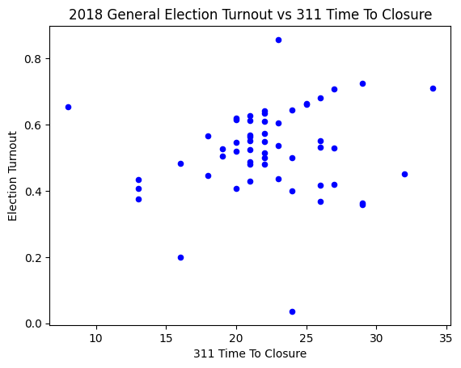
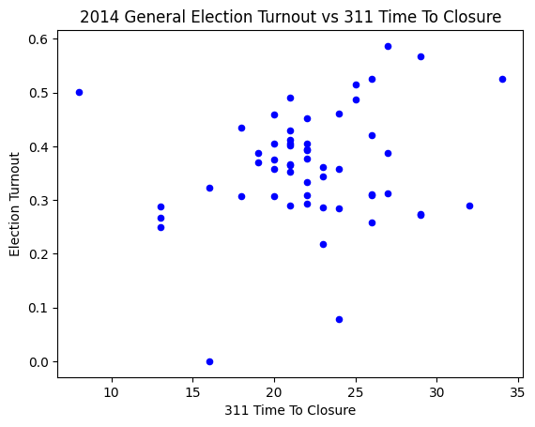
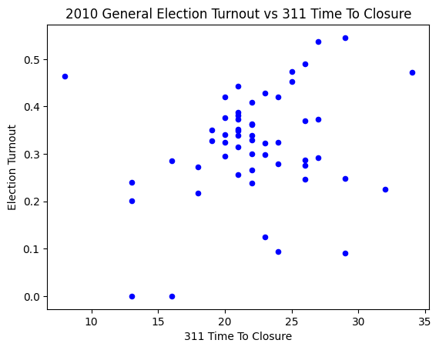
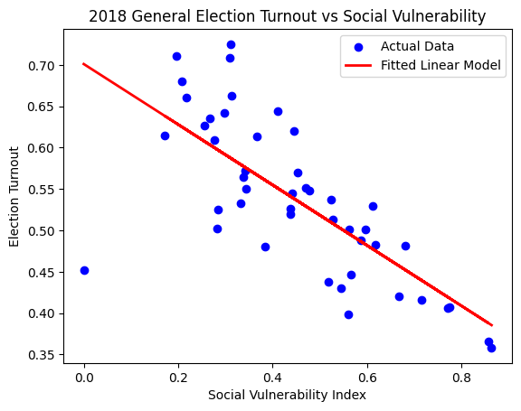
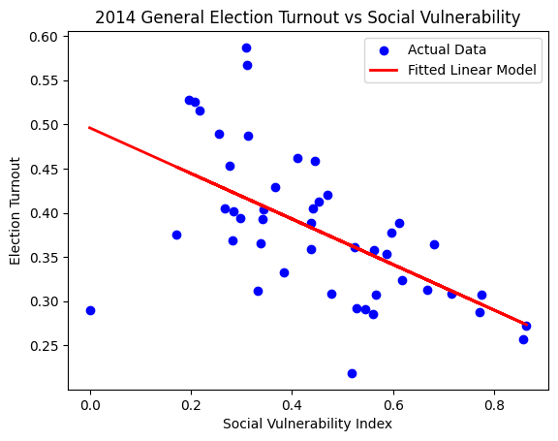
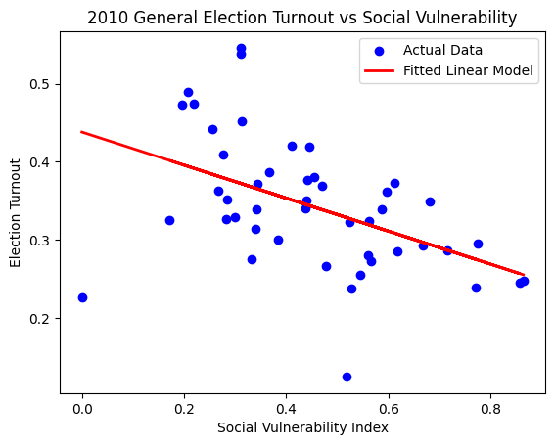
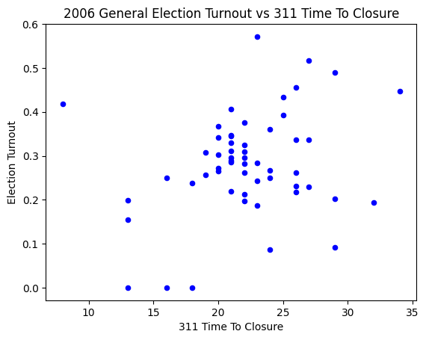
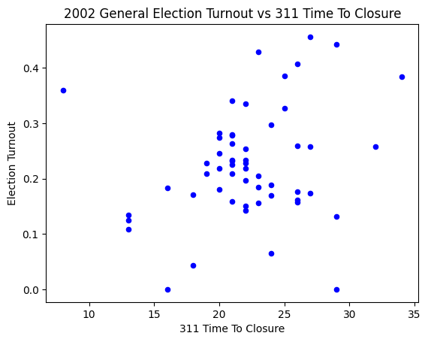
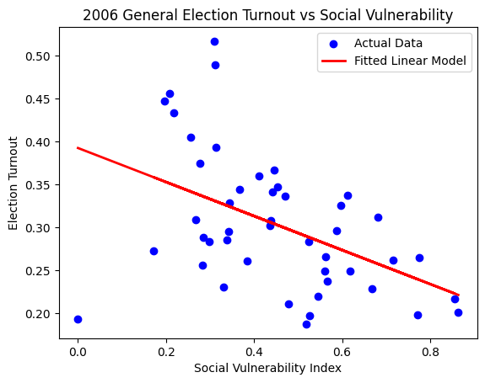
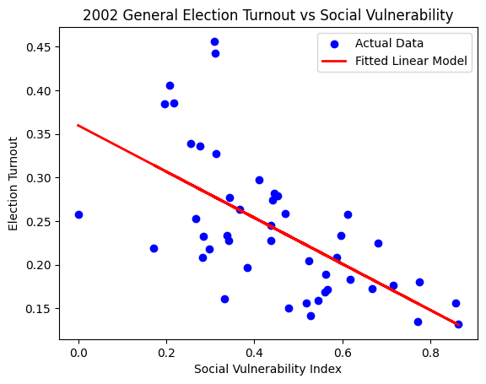
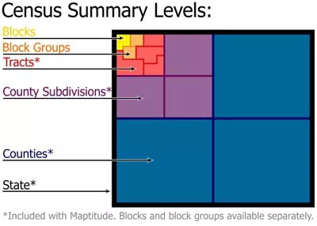
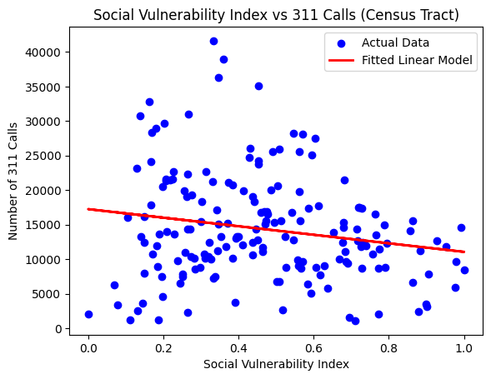
sd
Analyzing 311 Responses
Team 1 : Ivan Nikitovic - Haoxuan Sun - Stephen Wong
Strong negative relationship found between between voting turnout and SV Index. The more vulnerable a community is, the less likely they are to vote.
No relationship currently found between voting turnout and city responsiveness to 311 requests.
Weak negative relationship found between number of 311 calls and SV Index. The more empowered a community is, the more likely they are to call 311.

Slide 3
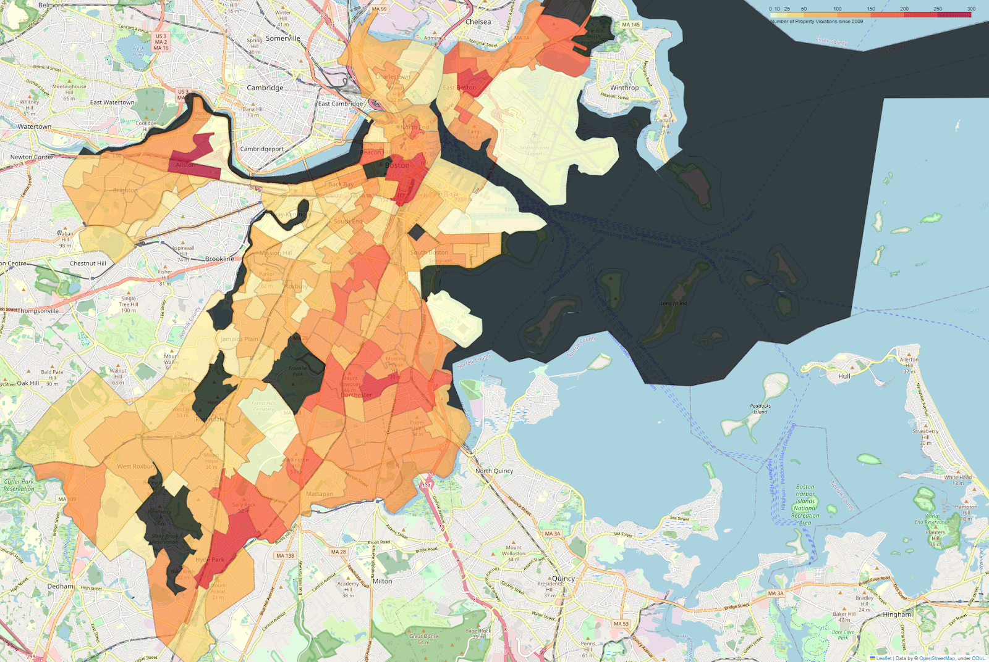
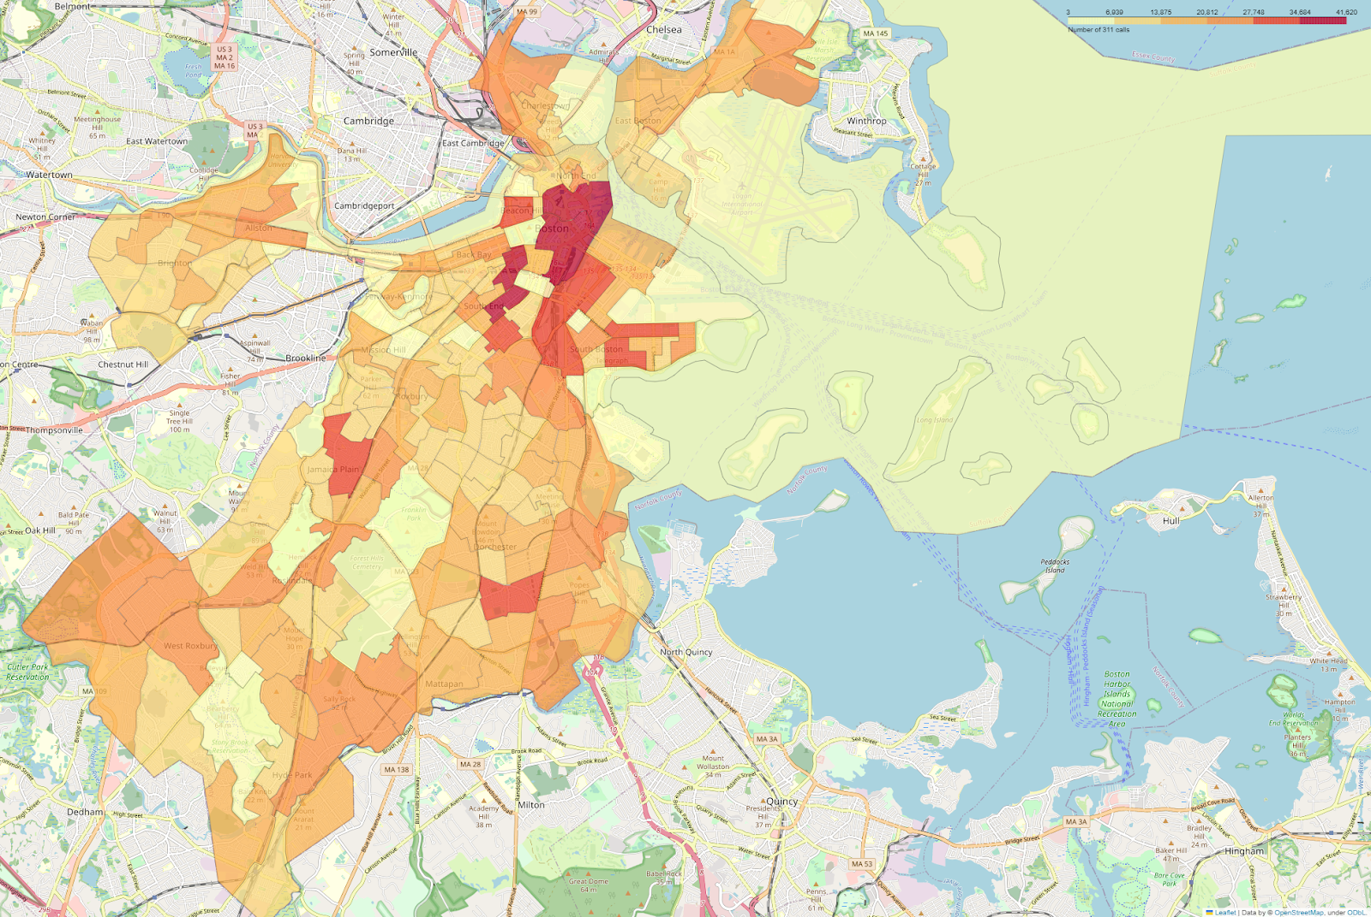
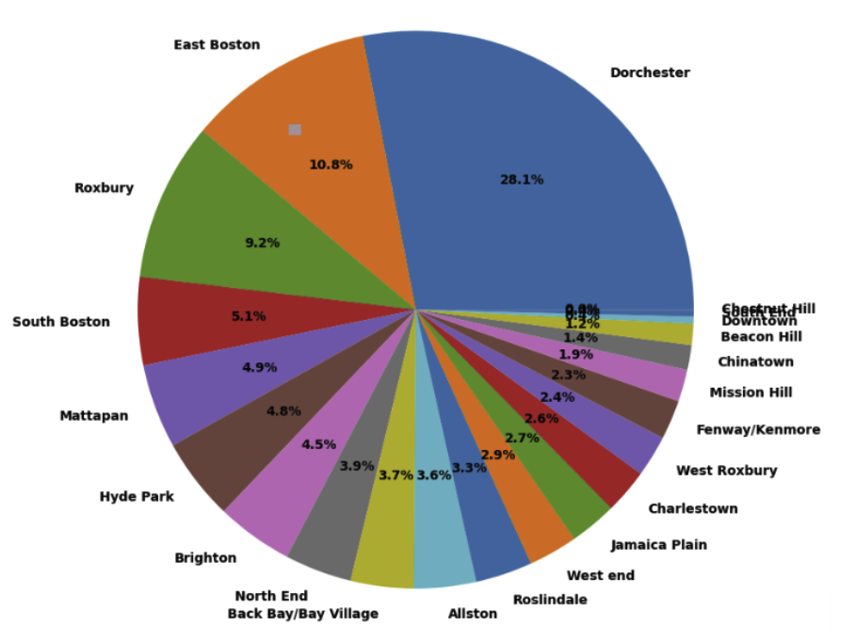
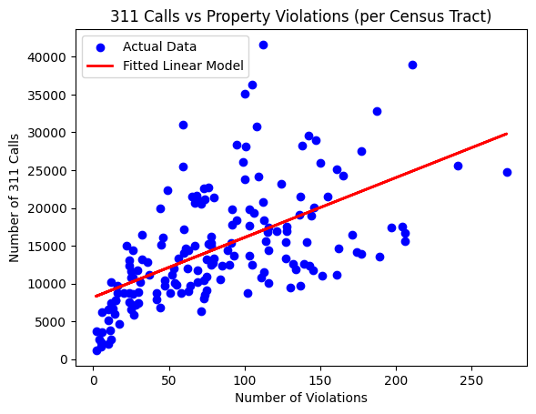
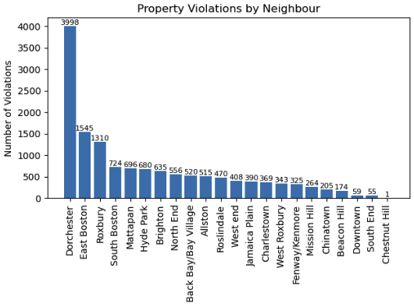
sd
Analyzing 311 Responses
Team 1 : Ivan Nikitovic - Haoxuan Sun - Stephen Wong
Number of Property Violations since 2009
Number of 311 Calls since 2010
Property Violations by City (Percentage)

